Slide 1

Diamond Price Prediction Model
Using Machine Learning

Slide 2

Description
In this presentation we will discuss The Diamond dataset. It is a valuable resource for analyzing and predicting the price of diamonds based on their characteristics. The dataset is widely used in the machine learning community for regression tasks related to diamond pricing. also, we will examine the various columns of the Diamond dataset, explore the insights we can gain from it, and discuss how it can be used to build predictive models for diamond pricing.

Slide 3
Features
Price - This column represents the price of the diamond in US dollars. The prices range from $326 to $18,823.
Carat - This column represents the weight of the diamond in carats. The weights range from 0.2 to 5.01 carats.
Cut - This column represents the quality of the cut of the diamond. There are five categories of cut quality: Fair, Good, Very Good, Premium, and Ideal.
Color - This column represents the color of the diamond, with values ranging from J (worst) to D (best).
Clarity - This column represents the clarity of the diamond, with values ranging from I1 (worst) to IF (best). Clarity is a measurement of how clear the diamond is.
x - This column represents the length of the diamond in millimeters, with values ranging from 0 to 10.74 mm.
y - This column represents the width of the diamond in millimeters, with values ranging from 0 to 58.9 mm.
z - This column represents the depth of the diamond in millimeters, with values ranging from 0 to 31.8 mm.
Depth - This column represents the total depth percentage of the diamond. The depth percentage is calculated as 2 * z / (x + y) and ranges from 43 to 79.
Table - This column represents the width of the top of the diamond relative to the widest point, with values ranging from 43 to 95.

Slide 4
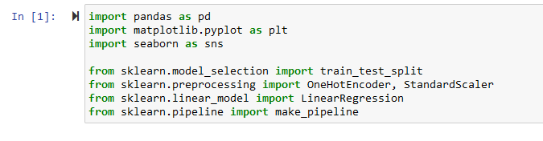
Import libraries

Slide 5
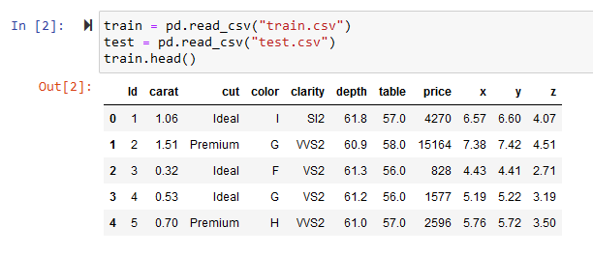
Loading data

Slide 6
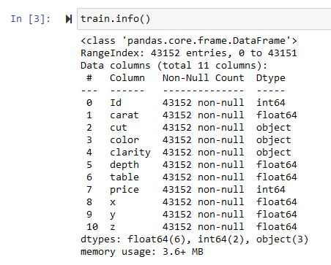
Exploratory data analysis (EDA)
First: Cleaning Data
We have 43152 rows, no null values and no wrong data types!

Slide 7
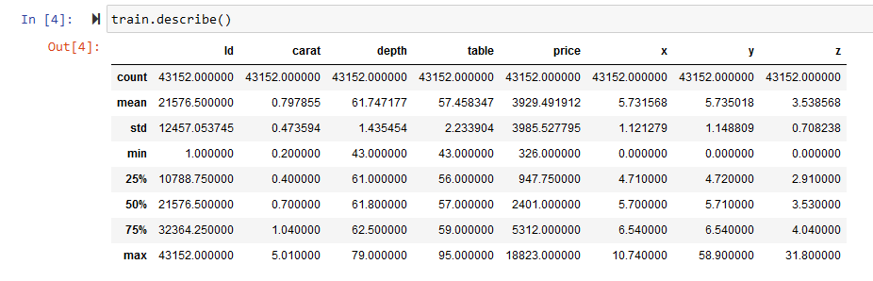
Exploratory data analysis (EDA)
First: Cleaning Data

Slide 8
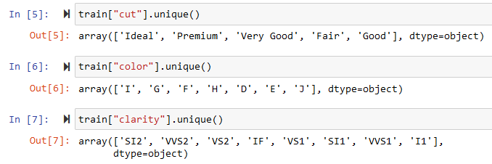
Exploratory data analysis (EDA)
Second: Exploring Data

Slide 9
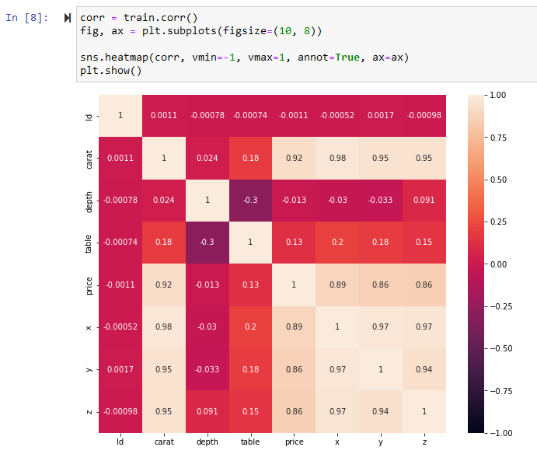
Exploratory data analysis (EDA)
Second: Exploring Data
As we can see on the above heatmap that "table" and "depth" columns have a low correlation with the price then we will not consider them in model training.

Slide 10
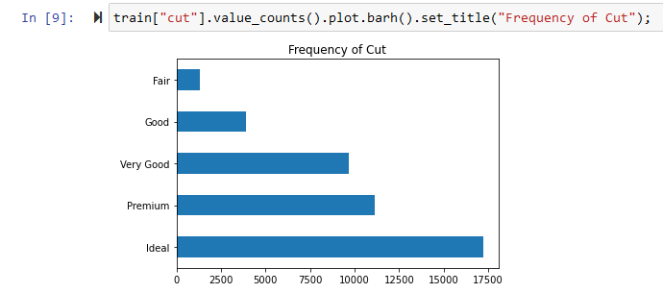
Exploratory data analysis (EDA)
Second: Exploring Data
What does the distribution of diamond prices for each cut category in the histogram tell us about the relationship between cut quality and price?

Slide 11
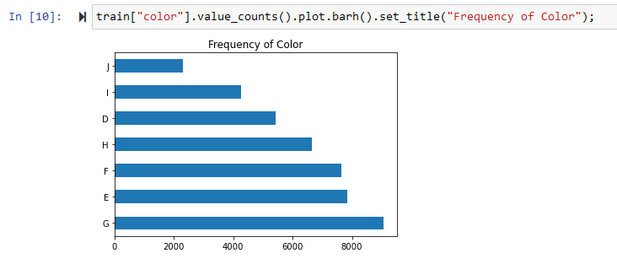
Exploratory data analysis (EDA)
Second: Exploring Data
What does the distribution of diamond prices for each color category in the histogram tell us about the relationship between diamond color and price?

Slide 12
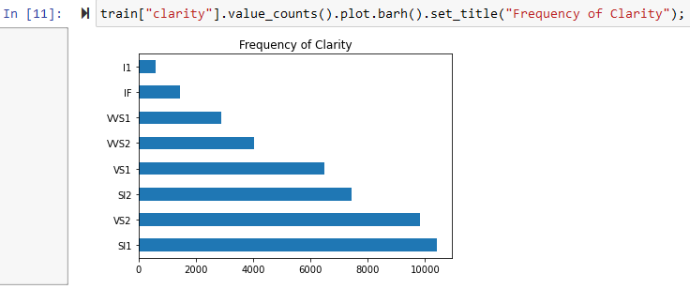
Exploratory data analysis (EDA)
Second: Exploring Data
What does the distribution of diamond prices for each clarity category in the histogram tell us about the relationship between diamond clarity and price?

Slide 13
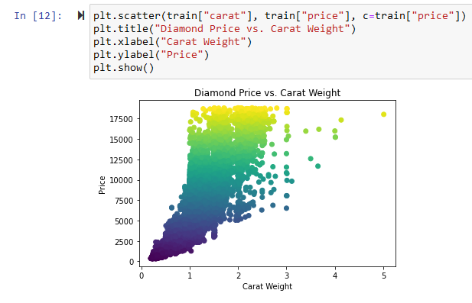
Exploratory data analysis (EDA)
Second: Exploring Data
How does the distribution of carat weight and price in the scatter plot reveal the relationship between these two variables, and what insights can we gain from it regarding the pricing of diamonds?

Slide 14
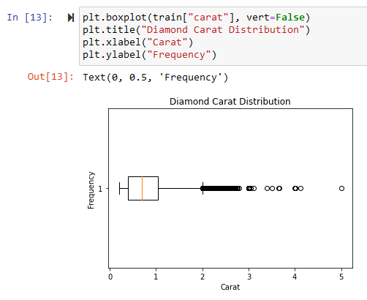
Exploratory data analysis (EDA)
Second: Exploring Data
If you have found outliers in the carat column of the Diamond dataset, it means that there are a few data points that are significantly different from the rest of the data. In other words, these diamonds have an unusually high or low carat weight compared to the other diamonds in the dataset.

Slide 15

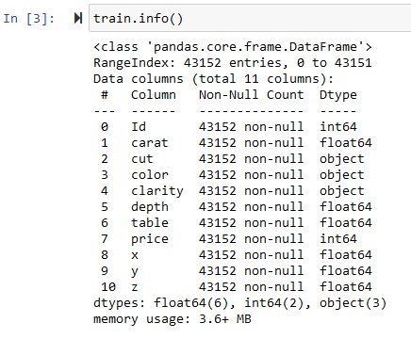
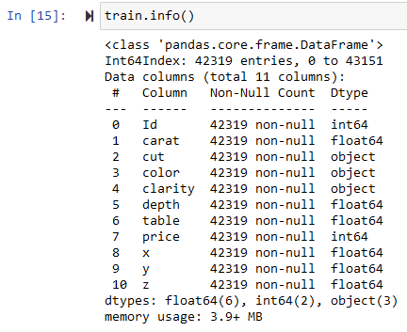
Exploratory data analysis (EDA)
Second: Exploring Data

Slide 16
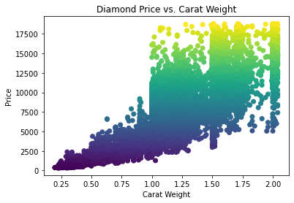
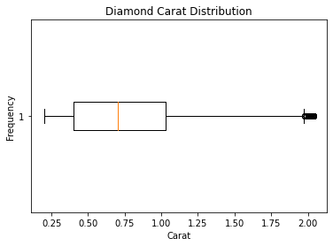
Exploratory data analysis (EDA)
Second: Exploring Data

Slide 17
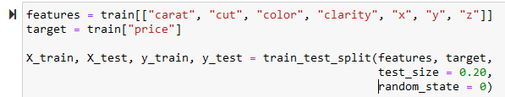
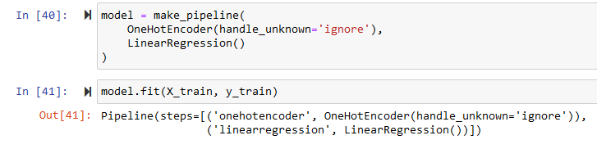
Train the model
Splitting Data into Train and Test sets
Model fitting

Slide 18
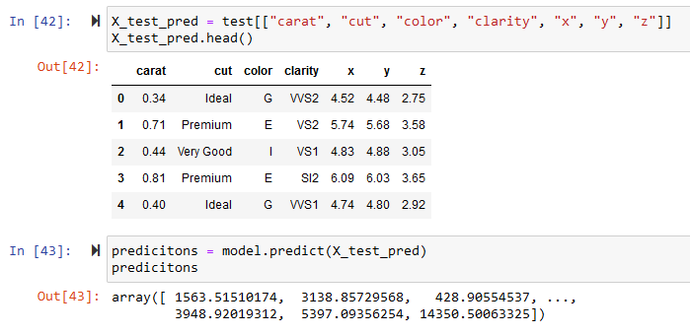
Model Predictions

